Slide 1
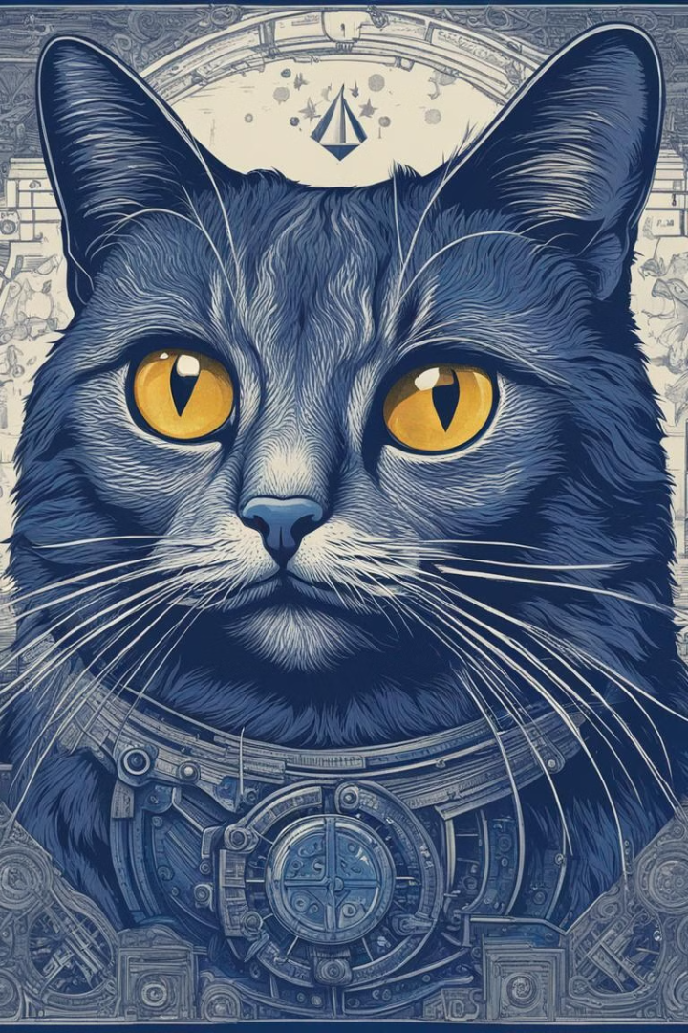
Schrödinger's cat
Schrödinger's cat is a famous thought experiment in quantum mechanics that explores the concept of superposition and the role of observation.
Imagine a cat locked in a box with a radioactive material and a vial of poison.
The radioactive material has a 50% chance of decaying within an hour, triggering a mechanism that releases the poison and kills the cat
If the material hasn't decayed after an hour, the poison vial remains unbroken, and the cat is alive.

Slide 2

Explanation of the thought experiment
Quantum Superposition
Life and Death Conundrum
Wave Function Collapse
Objects can exist in multiple states simultaneously until observed, leading to paradoxes.
The cat is both alive and dead until it is observed, illustrating quantum principles.
Observation causes the system to collapse into a single state, resolving the paradox.

Slide 3

Exploring Schrödinger's Thought Experiment
Schrödinger's thought experiment delves into the concept of quantum superposition, where objects can exist in multiple states simultaneously until observed, leading to paradoxes.
It illustrates the conundrum of life and death, with the cat being both alive and dead until observation. The wave function collapse occurs when the system is observed, resolving the paradox.

Slide 5

The concept of superposition
1
Simultaneous States
2
Probabilistic Nature
Objects can exist in multiple states at once, challenging classical physics.
Quantum particles exhibit probability distributions until observed, defying classical predictability.
3
Entanglement
Particles can become intertwined, affecting each other instantaneously regardless of distance.

Slide 6

The role of observation in quantum mechanics
1
Measurement Effect
Observer effect: Measurement alters the state, influencing the outcome.
2
Wave Function Collapse
Observation resolves superposition, determining the state of particles.
3
Interpretations
Different schools of thought regarding the significance of observation in quantum mechanics.

Slide 7
Criticisms and interpretations
Philosophical Debates
Measurement Problem
Hidden Variable Theories
Interpretations about consciousness and reality impact the understanding of quantum phenomena.
The role of observation raises questions about the nature of reality and uncertainty.
Proposed alternative explanations addressing the limitations of probabilistic interpretations.

Slide 8



Applications in popular culture
Movies and TV
Concepts like parallel universes and alternate timelines reflect quantum ideas.
Literature and Art
Inspires creative works exploring the nature of reality and perception.
Gaming and Comics
Quantum themes and paradoxes incorporated into entertainment media.

Slide 9
Current relevance and ongoing research
Quantum Computing
Quantum Biology
Quantum Cryptography
Developing technology based on quantum principles with potential for revolutionary applications.
Investigating quantum phenomena in biological systems, opening new frontiers of research.
Exploring secure communication methods based on quantum properties.

Slide 10
Conclusion and key takeaways
Complexity and Intrigue
Schrödinger's cat illustrates the mysterious and mind-bending nature of quantum theory.
Philosophical Implications
The thought experiment raises profound questions about reality and perception.
Technological Advances
Quantum concepts continue to drive innovation with transformative potential in diverse fields.

